Slide 1
CS525: Special Topics in DBs Large-Scale Data Management
MapReduce High-Level Langauges
Spring 2013 WPI, Mohamed Eltabakh

Slide 2
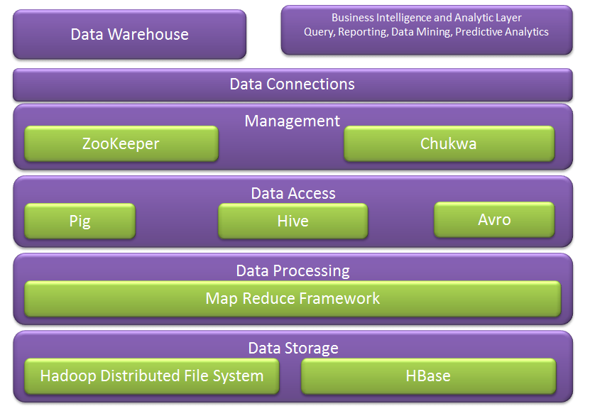
Hadoop Ecosystem
Next week we cover more of these
We covered these

Slide 3
Query Languages for Hadoop
Java: Hadoop’s Native Language
Pig: Query and Workflow Language
Hive: SQL-Based Language
HBase: Column-oriented Database for MapReduce

Slide 4
Java is Hadoop’s Native Language
Hadoop itself is written in Java
Provided Java APIs
For mappers, reducers, combiners, partitioners
Input and output formats
Other languages, e.g., Pig or Hive, convert their queries to Java MapReduce code

Slide 5
Levels of Abstraction
Less Hadoop
visible
HBase
Queries against tables
More DB view
Hive
SQL-Like language
Pig
Query and workflow language
Java
Write map-reduce functions
More Hadoop
visible
More map-reduce view

Slide 6
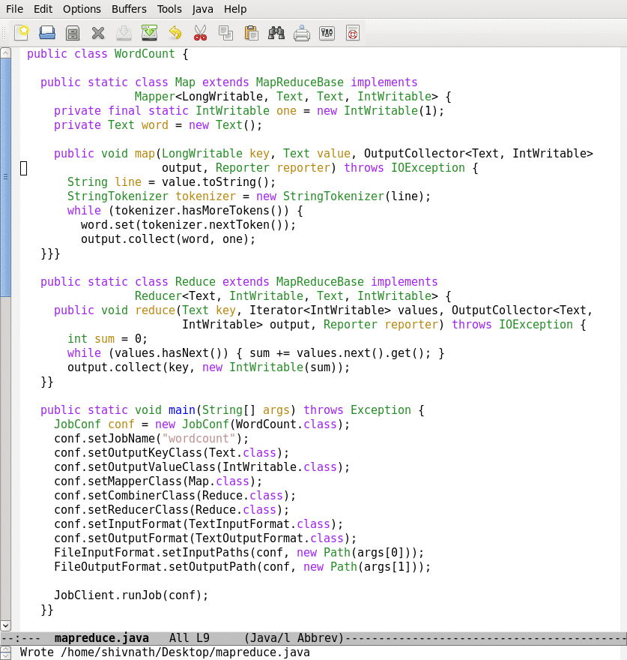
Java Example
map
reduce
Job conf.

Slide 7
Apache Pig

Slide 8

What is Pig
A platform for analyzing large data sets that consists of a high-level language for expressing data analysis programs.
Compiles down to MapReduce jobs
Developed by Yahoo!
Open-source language

Slide 9
High-Level Language
raw = LOAD 'excite.log' USING PigStorage('\t') AS (user, id, time, query);
clean1 = FILTER raw BY id > 20 AND id < 100;
clean2 = FOREACH clean1 GENERATE
user, time,
org.apache.pig.tutorial.sanitze(query) as query;
user_groups = GROUP clean2 BY (user, query);
user_query_counts = FOREACH user_groups
GENERATE group, COUNT(clean2), MIN(clean2.time), MAX(clean2.time);
STORE user_query_counts INTO 'uq_counts.csv' USING PigStorage(',');

Slide 10
Pig Components
High-level language (Pig Latin)
Set of commands
Two Main Components
Two execution modes
Local: reads/write to local file system
Mapreduce: connects to Hadoop cluster and reads/writes to HDFS
Interactive mode
Console
Two modes
Batch mode
Submit a script

Slide 11
Why Pig?...Abstraction!
Common design patterns as key words (joins, distinct, counts)
Data flow analysis
A script can map to multiple map-reduce jobs
Avoids Java-level errors (not everyone can write java code)
Can be interactive mode
Issue commands and get results

Slide 12
Example I: More Details
Read file from HDFS
The input format (text, tab delimited)
Define run-time schema
raw = LOAD 'excite.log' USING PigStorage('\t') AS (user, id, time, query);
clean1 = FILTER raw BY id > 20 AND id < 100;
clean2 = FOREACH clean1 GENERATE
user, time,
org.apache.pig.tutorial.sanitze(query) as query;
user_groups = GROUP clean2 BY (user, query);
user_query_counts = FOREACH user_groups
GENERATE group, COUNT(clean2), MIN(clean2.time), MAX(clean2.time);
STORE user_query_counts INTO 'uq_counts.csv' USING PigStorage(',');
Filter the rows on predicates
For each row, do some transformation
Grouping of records
Compute aggregation for each group
Store the output in a file
Text, Comma delimited

Slide 13
Pig: Language Features
Keywords
Load, Filter, Foreach Generate, Group By, Store, Join, Distinct, Order By, …
Aggregations
Count, Avg, Sum, Max, Min
Schema
Defines at query-time not when files are loaded
UDFs
Packages for common input/output formats

Slide 14
Example 2
Script can take arguments
Data are “ctrl-A” delimited
Define types of the columns
A = load '$widerow' using PigStorage('\u0001') as (name: chararray, c0: int, c1: int, c2: int);
B = group A by name parallel 10;
C = foreach B generate group, SUM(A.c0) as c0, SUM(A.c1) as c1, AVG(A.c2) as c2;
D = filter C by c0 > 100 and c1 > 100 and c2 > 100;
store D into '$out';
Specify the need of 10 reduce tasks

Slide 15
Example 3: Re-partition Join
Register UDFs & custom inputformats
Function the jar file to read the input file
register pigperf.jar;
A = load ‘page_views' using org.apache.pig.test.udf.storefunc.PigPerformanceLoader()
as (user, action, timespent, query_term, timestamp, estimated_revenue);
B = foreach A generate user, (double) estimated_revenue;
alpha = load ’users' using PigStorage('\u0001') as (name, phone, address, city, state, zip);
beta = foreach alpha generate name, city;
C = join beta by name, B by user parallel 40;
D = group C by $0;
E = foreach D generate group, SUM(C.estimated_revenue);
store E into 'L3out';
Load the second file
Join the two datasets (40 reducers)
Group after the join (can reference columns by position)
This grouping can be done in the same map-reduce job because it is on the same key (Pig can do this optimization)

Slide 16
Example 4: Replicated Join
register pigperf.jar;
A = load ‘page_views' using org.apache.pig.test.udf.storefunc.PigPerformanceLoader()
as (user, action, timespent, query_term, timestamp, estimated_revenue);
Big = foreach A generate user, (double) estimated_revenue;
alpha = load ’users' using PigStorage('\u0001') as (name, phone, address, city, state, zip);
small = foreach alpha generate name, city;
C = join Big by user, small by name using ‘replicated’;
store C into ‘out';
Map-only join (the small dataset is the second)
Optimization in joining a big dataset with a small one

Slide 17
Example 5: Multiple Outputs
A = LOAD 'data' AS (f1:int,f2:int,f3:int);
DUMP A;
(1,2,3)
(4,5,6)
(7,8,9)
SPLIT A INTO X IF f1<7, Y IF f2==5, Z IF (f3<6 OR f3>6);
DUMP X;
(1,2,3)
(4,5,6)
DUMP Y;
(4,5,6)
STORE x INTO 'x_out';
STORE y INTO 'y_out';
STORE z INTO 'z_out';
Split the records into sets
Dump command to display the data
Store multiple outputs

Slide 18
Run independent jobs in parallel
D1 = load 'data1' …
D2 = load 'data2' …
D3 = load 'data3' …
C1 = join D1 by a, D2 by b
C2 = join D1 by c, D3 by d
C1 and C2 are two independent jobs that can run in parallel

Slide 19
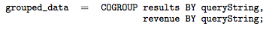
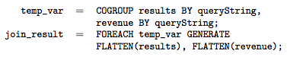
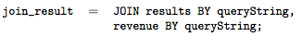
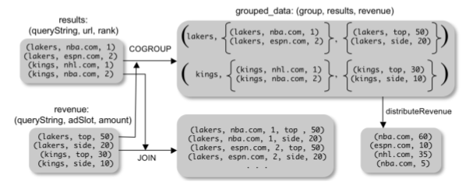
Pig Latin: CoGroup
Combination of join and group by
Make use of Pig nested structure

Slide 20
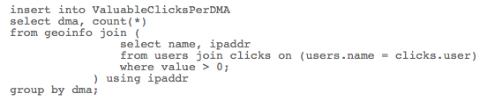
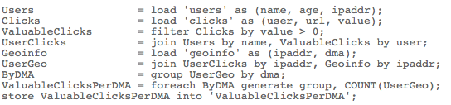
Pig Latin vs. SQL
Pig Latin is procedural (dataflow programming model)
Step-by-step query style is much cleaner and easier to write
SQL is declarative but not step-by-step style
SQL
Pig
Latin

Slide 21
Pig Latin vs. SQL
In Pig Latin
Lazy evaluation (data not processed prior to STORE command)
Data can be stored at any point during the pipeline
Schema and data types are lazily defined at run-time
An execution plan can be explicitly defined
Use optimizer hints
Due to the lack of complex optimizers
In SQL:
Query plans are solely decided by the system
Data cannot be stored in the middle
Schema and data types are defined at the creation time

Slide 22
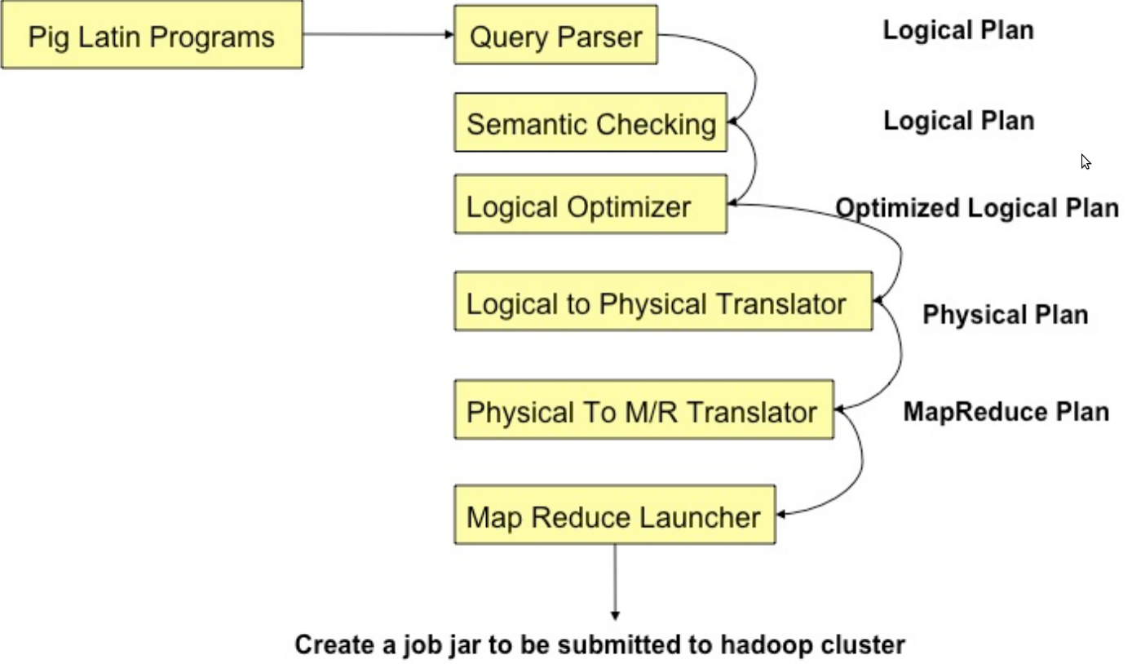
Pig Compilation

Slide 23
Logic Plan
A=LOAD 'file1' AS (x, y, z);
B=LOAD 'file2' AS (t, u, v);
C=FILTER A by y > 0;
D=JOIN C BY x, B BY u;
E=GROUP D BY z;
F=FOREACH E GENERATE group, COUNT(D);
STORE F INTO 'output';
LOAD
LOAD
FILTER
JOIN
GROUP
FOREACH
STORE

Slide 24
Physical Plan
1:1 correspondence with the logical plan
Except for:
Join, Distinct, (Co)Group, Order
Several optimizations are done automatically

Slide 25
Generation of Physical Plans
If the Join and Group By are on the same key ➔ The two map-reduce jobs would be merged into one.

Slide 26
Java vs. Pig
Performance is comparable (Java is slightly better)

Slide 27
Pig References
Pig Tutorial
http://pig.apache.org/docs/r0.7.0/tutorial.html
Pig Latin Reference Manual 2
http://pig.apache.org/docs/r0.7.0/piglatin_ref1.html
Pig Latin Reference Manual 2
http://pig.apache.org/docs/r0.7.0/piglatin_ref2.html
PigMix Queries
https://cwiki.apache.org/PIG/pigmix.html

Slide 28

Apache Pig

Slide 29
Hive

Slide 30

Apache Hive
A data warehouse infrastructure built on top of Hadoop for providing data summarization, query, and analysis
Hive Provides
ETL
Structure
Access to different storage (HDFS or HBase)
Query execution via MapReduce
Key Building Principles
SQL is a familiar language
Extensibility – Types, Functions, Formats, Scripts
Performance

Slide 31
Hive Components
High-level language (HiveQL)
Set of commands
Two Main Components
Two execution modes
Local: reads/write to local file system
Mapreduce: connects to Hadoop cluster and reads/writes to HDFS
Interactive mode
Console
Two modes
Batch mode
Submit a script

Slide 32
Hive deals with Structured Data
Data Units
Databases
Tables
Partitions
Buckets (or clusters)
Very similar to SQL and Relational DBs

Slide 33
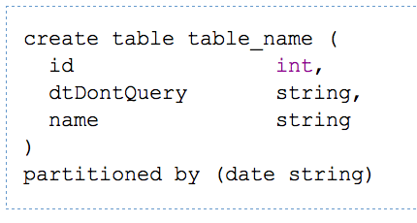
Hive DDL Commands
CREATE TABLE sample (foo INT, bar STRING) PARTITIONED BY (ds STRING);
SHOW TABLES '.*s';
DESCRIBE sample;
ALTER TABLE sample ADD COLUMNS (new_col INT);
DROP TABLE sample;
A table in Hive is an HDFS directory in Hadoop
Schema is known at creation time (like DB schema)
Partitioned tables have “sub-directories”, one for each partition

Slide 34
Hive DML
Load data from local file system
Delete previous data from that table
LOAD DATA LOCAL INPATH './sample.txt' OVERWRITE INTO TABLE sample;
LOAD DATA INPATH '/user/falvariz/hive/sample.txt’ INTO TABLE partitioned_sample PARTITION (ds='2012-02-24');
Load data from HDFS
Augment to the existing data
Must define a specific partition for partitioned tables
Loaded data are files copied to HDFS under the corresponding directory

Slide 35
Hive Components
Hive CLI: Hive Client Interface
MetaStore: For storing the schema information, data types, partitioning columns, etc…
Hive QL: The query language, compiler, and executer

Slide 36
Data Model
3-Levels: Tables → Partitions → Buckets
Table: maps to a HDFS directory
Table R: Users all over the world
Partition: maps to sub-directories under the table
Partition R by country name
It is the user’s responsibility to upload the right data to the right partition
Bucket: maps to files under each partition
Divide a partition into buckets based on a hash function on a certain column(s)

Slide 37
Data Model (Cont’d)

Slide 38
Query Examples I: Select & Filter
SELECT foo FROM sample WHERE ds='2012-02-24';
INSERT OVERWRITE DIRECTORY '/tmp/hdfs_out' SELECT * FROM sample WHERE ds='2012-02-24';
INSERT OVERWRITE LOCAL DIRECTORY '/tmp/hive-sample-out' SELECT * FROM sample;
Create HDFS dir for the output
Create local dir for the output

Slide 39
Query Examples II: Aggregation & Grouping
SELECT MAX(foo) FROM sample;
SELECT ds, COUNT(*), SUM(foo) FROM sample GROUP BY ds;
FROM sample s INSERT OVERWRITE TABLE bar SELECT s.bar, count(*) WHERE s.foo > 0 GROUP BY s.bar;
Hive allows the From clause to come first !!!
Store the results into a table
This new syntax is to facilitate the “Multi-Insertion”

Slide 40
Query Examples III: Multi-Insertion
FROM page_view_stg pvs
INSERT OVERWRITE TABLE page_view PARTITION(dt='2008-06-08', country='US')
SELECT pvs.viewTime, … WHERE pvs.country = 'US'
INSERT OVERWRITE TABLE page_view PARTITION(dt='2008-06-08', country='CA')
SELECT pvs.viewTime, ... WHERE pvs.country = 'CA'
INSERT OVERWRITE TABLE page_view PARTITION(dt='2008-06-08', country='UK')
SELECT pvs.viewTime, ... WHERE pvs.country = 'UK';

Slide 41
Example IV: Joins
CREATE TABLE customer (id INT,name STRING,address STRING)
ROW FORMAT DELIMITED FIELDS TERMINATED BY '#';
CREATE TABLE order_cust (id INT,cus_id INT,prod_id INT,price INT)
ROW FORMAT DELIMITED FIELDS TERMINATED BY '\t';
SELECT * FROM customer c JOIN order_cust o ON (c.id=o.cus_id);
SELECT c.id, c.name, c.address, ce.exp
FROM customer c JOIN (SELECT cus_id,sum(price) AS exp
FROM order_cust
GROUP BY cus_id) ce ON (c.id=ce.cus_id);

